Slide 1
Kmeans Variants

Slide 2
Limitation of KMeans
It is sensitive to the initialization of the centroids or the mean points. So, if a centroid is initialized to be a “far-off” point, it might just end up with no points associated with it, and at the same time, more than one cluster might end up linked with a single centroid.
More than one centroid might be initialized into the same cluster resulting in poor clustering.

Slide 3
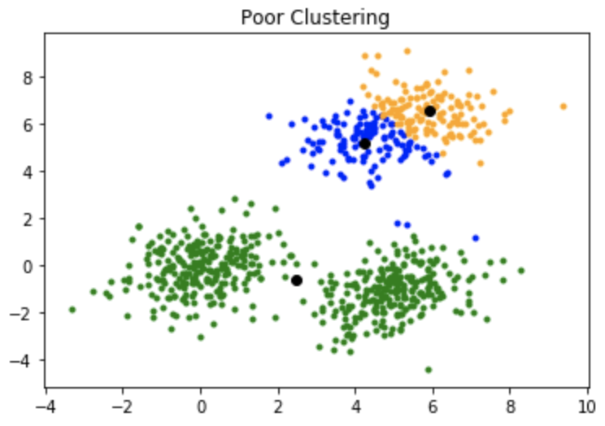
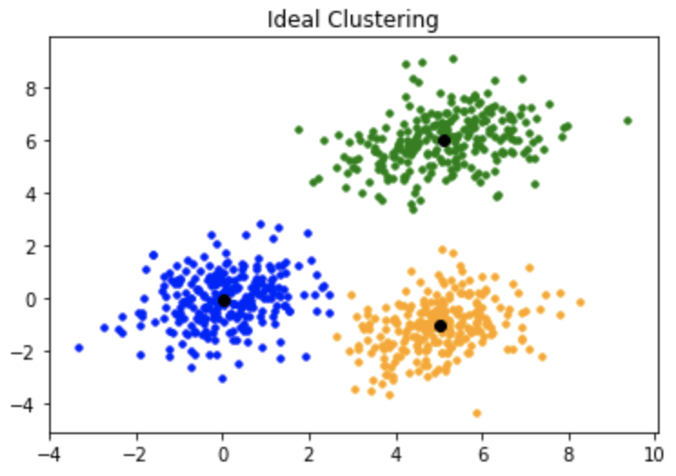
A poor initialization of centroids resulted in poor clustering.
This is how the clustering should have been:

Slide 4
Kmeans++
KMeans++ is an improved initialization technique for the KMeans clustering algorithm.
The primary goal of KMeans++ is to provide a better initial set of cluster centroids, which in turn leads to faster convergence and higher-quality clustering results compared to the standard random initialization used in traditional KMeans.

Slide 5
Kmeans++ Algorithm
Select the First Centroid:
Choose one data point randomly from the dataset as the first centroid.
Calculate Distances:
For each data point that has not been selected as a centroid, calculate the distance (usually using Euclidean distance) from that point to the nearest centroid that has already been chosen.
Select Subsequent Centroids:
The next centroid is chosen from the remaining data points with a probability proportional to the square of the distance from the nearest existing centroid. This ensures that points that are far from existing centroids are more likely to be selected as new centroids.
Repeat Step 2 and 3:
Repeat the distance calculation and centroid selection process until the desired number of centroids is reached.

Slide 6
Kmeans++ Numerical
Let's say we have a small dataset of two-dimensional points:
Data Points:
(2, 3), (3, 2), (8, 8), (10, 9), (11, 10)
We want to perform KMeans clustering with K=2 clusters.

Slide 7
Step 1
Select First Centroid:
Choose a random data point as the first centroid. Let's say we choose (2, 3).

Slide 8
Step 2
Calculate Distances:
Calculate the squared distances from each data point to the chosen centroid (2, 3):
Distance from (3, 2) = (3 - 2)^2 + (2 - 3)^2 = 2
Distance from (8, 8) = (8 - 2)^2 + (8 - 3)^2 = 61
Distance from (10, 9) = (10 - 2)^2 + (9 - 3)^2 = 100
Distance from (11, 10) = (11 - 2)^2 + (10 - 3)^2 = 130

Slide 9
Step 3
Select Subsequent Centroid:
The next centroid is selected based on the calculated squared distances. The probability of selecting a point as the next centroid is proportional to its squared distance from the nearest existing centroid.
Calculate the probabilities for each point:
Probability for (3, 2) = 2 / (2 + 61 + 100 + 130) ≈ 0.0068
Probability for (8, 8) = 61 / (2 + 61 + 100 + 130) ≈ 0.208
Probability for (10, 9) = 100 / (2 + 61 + 100 + 130) ≈ 0.341
Probability for (11, 10) = 130 / (2 + 61 + 100 + 130) ≈ 0.443
Choose the next centroid based on these probabilities.

Slide 10
Step 4
Repeat Steps 2 and 3:
Recalculate distances from each data point to the two centroids (2, 3) and (11,10) and calculate new probabilities.
Choose the third centroid based on the probabilities.

Slide 11
Implement Kmeans++ algorithm on make_blobs dataset using and without using Kmeans library.

Slide 12
KMedians
"KMedians," another clustering algorithm that is similar to KMeans but uses medians instead of means to calculate the cluster centroids.
Medians is particularly useful when dealing with data that might have outliers or when you want to create clusters based on the median values of the data points rather than the mean values.

Slide 13
Kmedians Algorithm
Initialization:
Just like KMeans, KMedians also requires an initial set of cluster centroids. These centroids can be randomly chosen data points or selected using other methods.
Assignment Step:
Each data point is assigned to the nearest centroid based on the Manhattan distance (also known as L1 distance) rather than Euclidean distance, which is used in KMeans. The Manhattan distance is the sum of the absolute differences between the coordinates of the data point and the centroid.
Update Step:
After the assignment step, the medians of the data points in each cluster are calculated. The median value of a set of numbers is the middle value when they are sorted in order. It's a more robust measure than the mean because it's less affected by outliers.
Iteration:
The assignment and update steps are repeated iteratively until convergence. In each iteration, data points are reassigned to the nearest centroids based on Manhattan distance, and then the centroids are updated using the medians of the data points in each cluster.

Slide 14
Advantages of KMedians
The main advantage of KMedians over KMeans is its robustness to outliers.
Outliers can significantly influence the mean-based centroids in KMeans, whereas medians are less affected by extreme values.
However, KMedians can also be computationally more expensive than KMeans since calculating medians involves sorting data points.

Slide 15
Kmedians Numerical
Let's consider a small dataset of one-dimensional points:
Data Points: 2, 3, 7, 8, 10, 12, 15, 20, 25
Assuming we want to perform KMedians clustering with K=2 clusters.

Slide 16
Step 1
Initialization:
Choose two initial medians randomly or using some other initialization method. Let's say we start with medians at 7 and 20.

Slide 17
Step 2
Assignment Step:
For each data point, calculate the Manhattan distance (L1 distance) from each of the cluster medians. Assign each data point to the nearest median's cluster.
Data
Point |Median 7|Median 20| Assigned Cluster
-----------------------------------------------------------------
2 | 5 | 18 | 1
3 | 4 | 17 | 1
7 | 0 | 13 | 1
8 | 1 | 12 | 1
10 | 3 | 10 | 1
12 | 5 | 8 | 1
15 | 8 | 5 | 2
20 | 13 | 0 | 2
25 | 18 | 5 | 2

Slide 18
Step 3
Update Step (Calculation of Medians):
For each cluster, calculate the median of the data points in that cluster. The median is the middle value when the data points are sorted.
Repeat the assignment and update steps until convergence. In each iteration, reassign data points to the nearest medians and update the medians based on the median of the data points in each cluster.
Cluster 1 Median: 7
Cluster 2 Median: 20

Slide 19
Example
Let's consider a small dataset of one-dimensional points:
Data Points: Points: (2, 4), (3, 6), (5, 8), (10, 12), (12, 14), (15, 18), (20, 25), (25, 30)
Assuming we want to perform KMedians clustering with K=2 clusters.
Suppose
Cluster 1 centroid: (3, 6) Cluster 2 centroid: (15, 18)

Slide 20
Implement Kmedian algorithm using make_blobs dataset

Slide 21
K-Medoids
K-Medoids is particularly useful when dealing with non-numerical data or when you want clusters that are centered around actual data points.
"K-Medoids," is a clustering algorithm similar to KMeans but uses actual data points as cluster representatives (medoids) instead of the mean or centroid.

Slide 22
K-Medoids
Initialization:
Choose K initial data points as medoids (cluster representatives). These can be randomly selected data points or chosen using other methods.
Assignment Step:
Each data point is assigned to the nearest medoid based on a distance metric (usually something like Manhattan distance, Euclidean distance, etc.).
Update Step:
For each cluster, compute the total cost (sum of distances) of assigning each data point in the cluster to the medoid.
Select the data point with the lowest total cost as the new medoid for that cluster.
Iteration:
Repeat the assignment and update steps until the medoids stabilize, which indicates convergence.
The main advantage of K-Medoids is its robustness to outliers and its ability to handle non-numerical data types. Since the medoid is an actual data point, it is less affected by extreme values or noise in the data.

Slide 23
K-Medoid
K-Medoids is particularly useful when dealing with non-numerical data or when you want clusters that are centered around actual data points.
"K-Medoids," is a clustering algorithm similar to KMeans but uses actual data points as cluster representatives (medoids) instead of the mean or centroid.
Medoids are representative objects of a data set or a cluster within a data set whose sum of dissimilarities to all the objects in the cluster is minimal.
Medoids are similar in concept to means or centroids, but medoids are always restricted to be members of the data set.
Medoids are most commonly used on data when a mean or centroid cannot be defined, such as graphs.

Slide 24
K-Medoid
First, we select K random data points from the dataset and use them as medoids.
Now, we will calculate the distance of each data point from the medoids. You can use any of the Euclidean, Manhattan distance, or squared Euclidean distance as the distance measure.
Once we find the distance of each data point from the medoids, we will assign the data points to the clusters associated with each medoid. The data points are assigned to the medoids at the closest distance.
After determining the clusters, we will calculate the sum of the distance of all the non-medoid data points to the medoid of each cluster. Let the cost be C_{i}.

Slide 25
5. Now, we will select a random data point D_{j} from the dataset and swap it with a medoid M_{i}. Here, D_{j} becomes a temporary medoid. After swapping, we will calculate the distance of all the non-medoid data points to the current medoid of each cluster. Let this cost be C_{j}.
6. If C_{i}>C_{j}, the current medoids with D_{j} as one of the medoids are made permanent medoids. Otherwise, we undo the swap, and M_{i} is reinstated as the medoid.
7. Repeat 4 to 6 until no change occurs in the clusters.

Slide 26
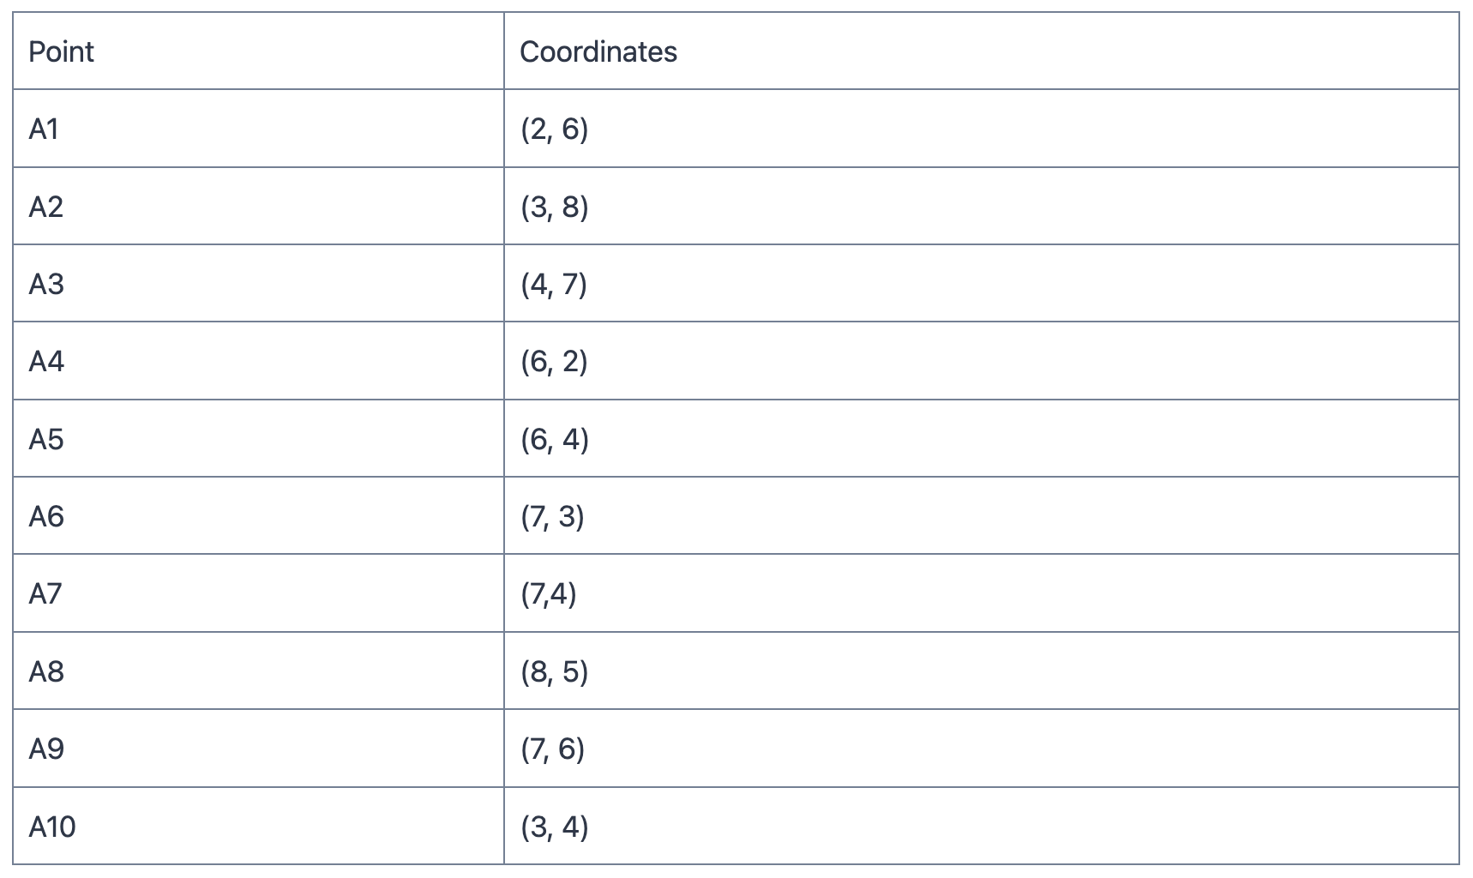
K-Medoids Numerical

Slide 27
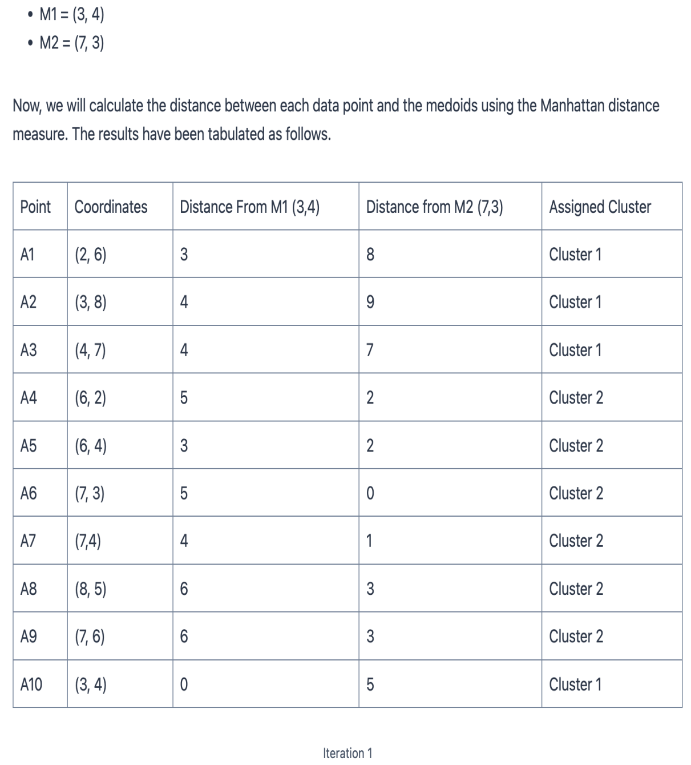

Slide 28
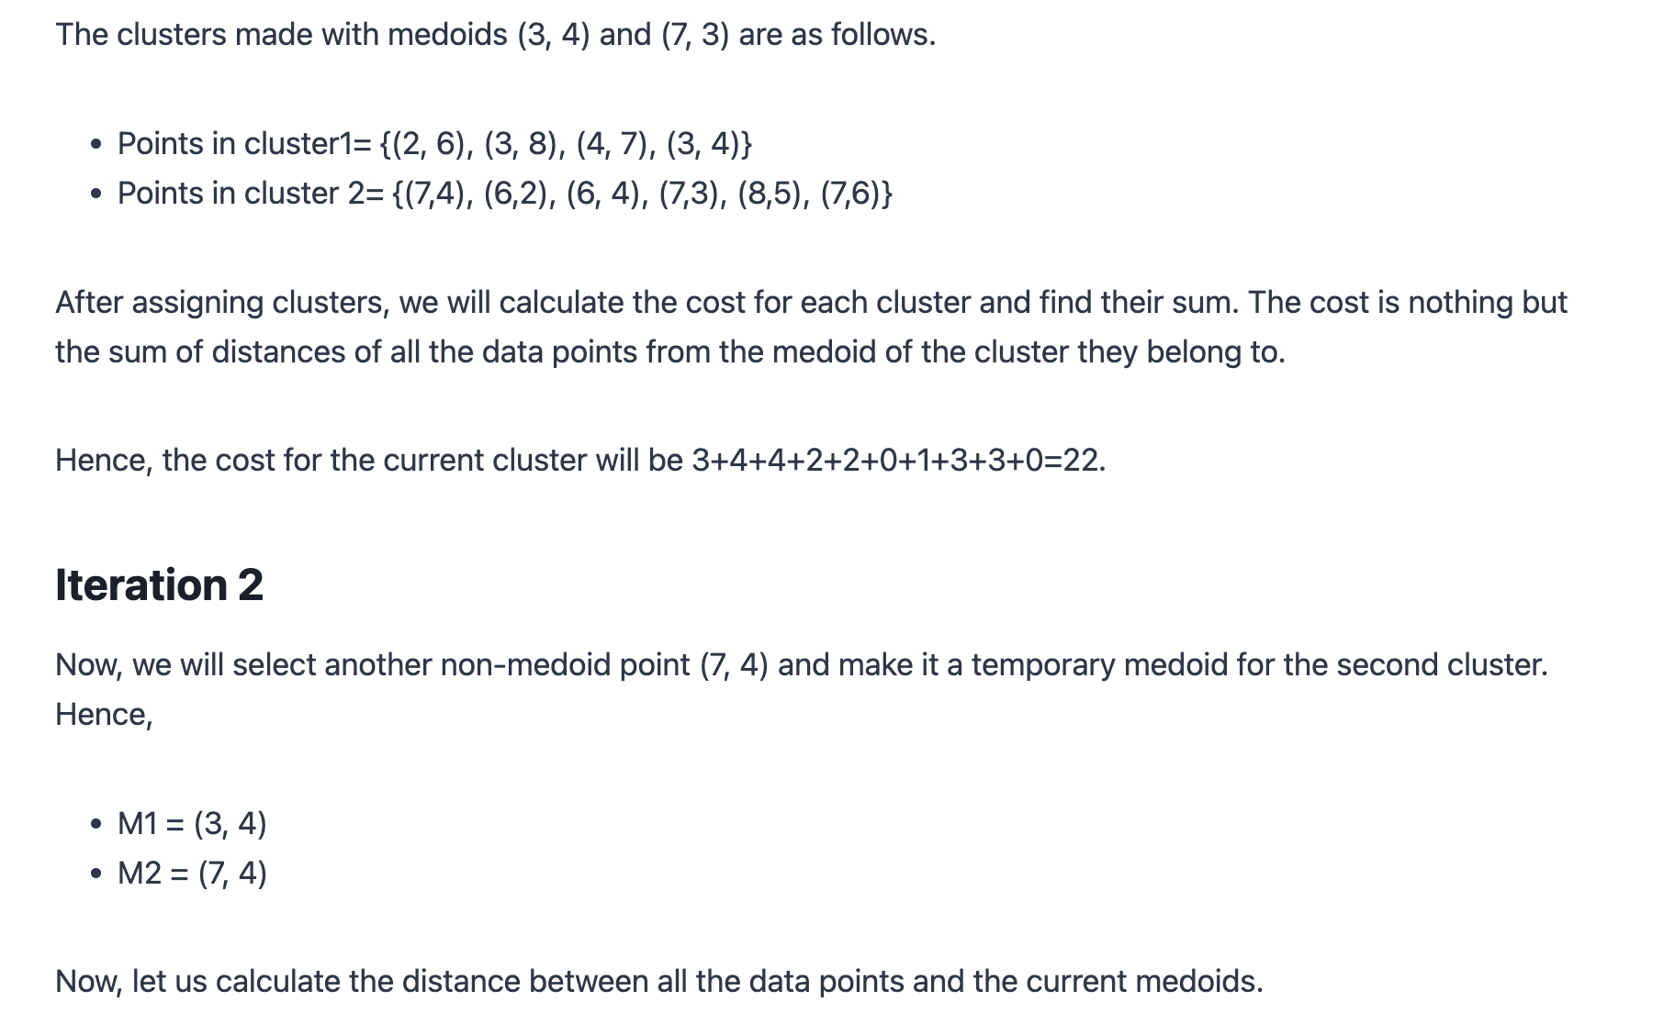

Slide 29
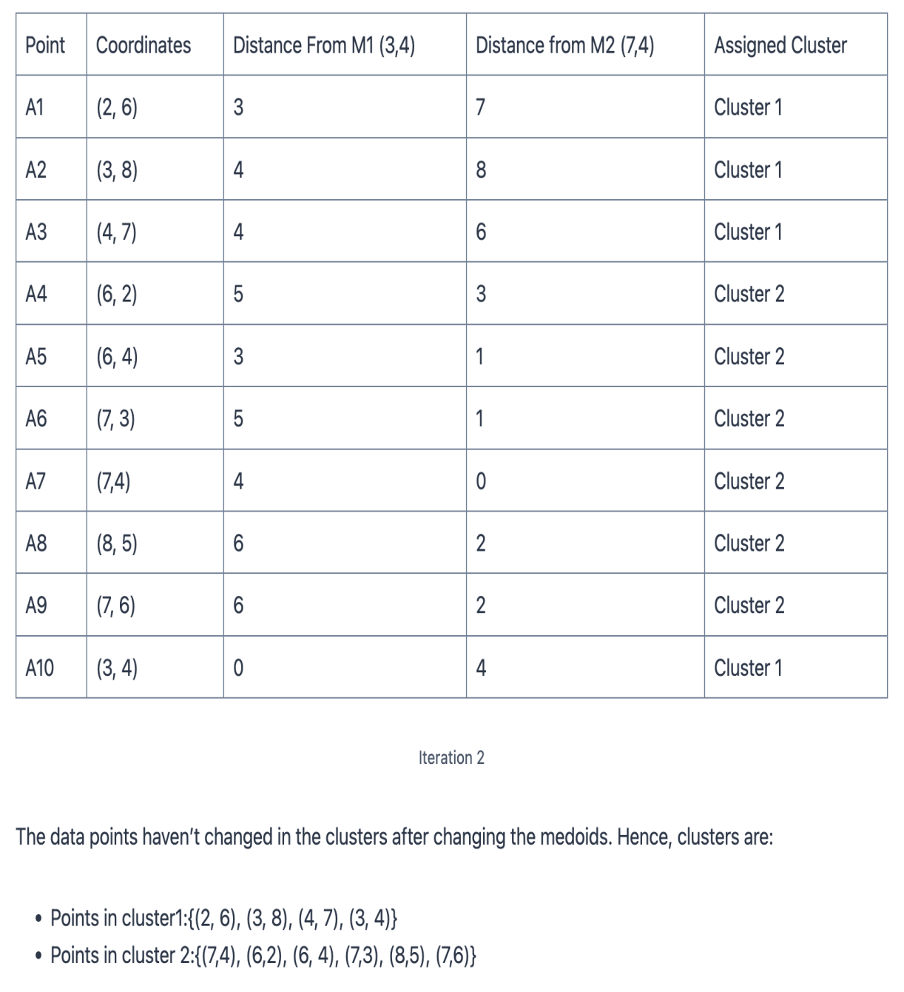

Slide 30
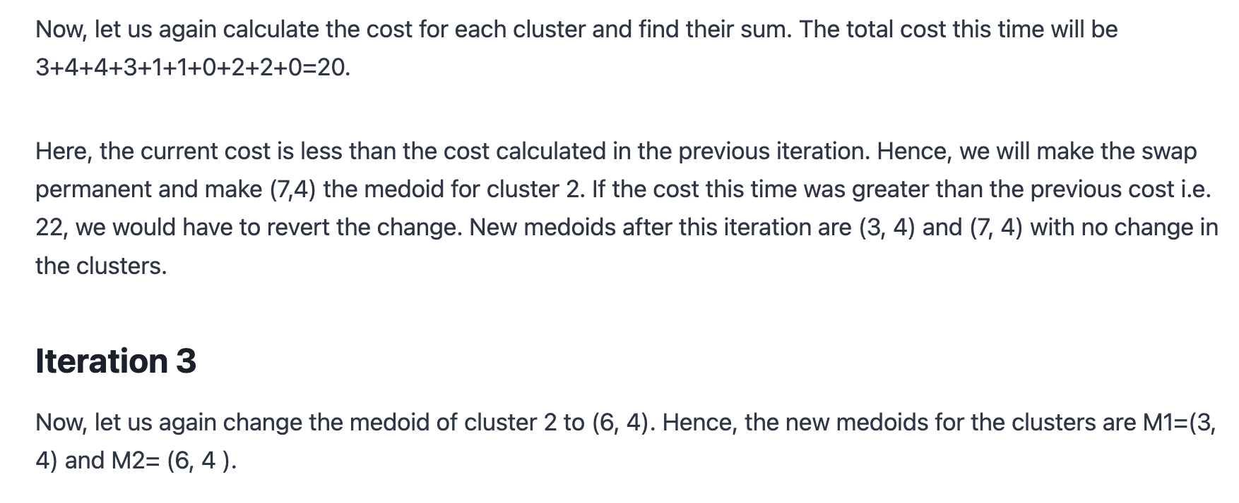

Slide 31
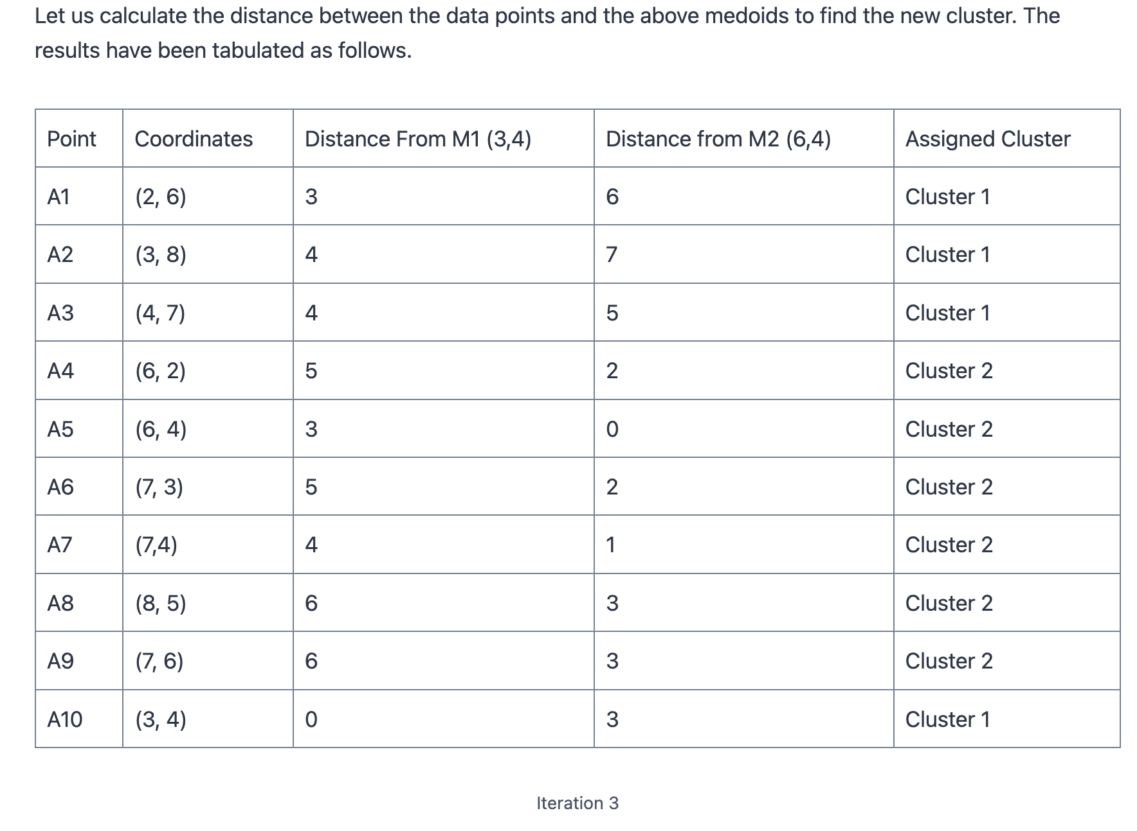

Slide 32
